Slide 1


in Barcelona

Slide 2
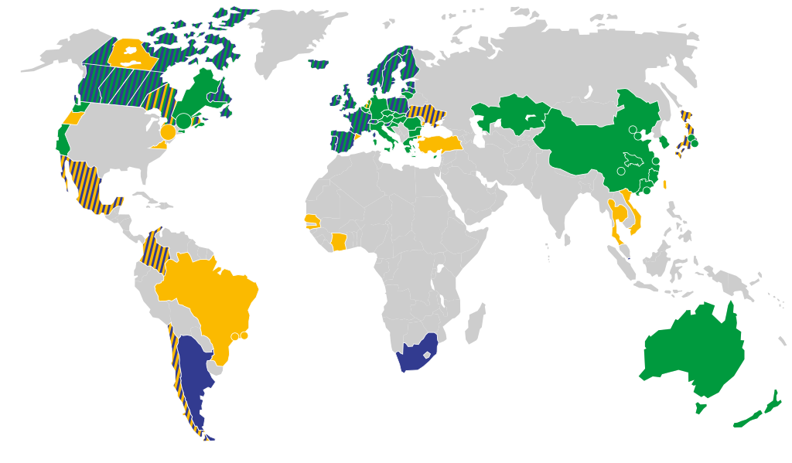
Detemining a New Brach for Nusret in Barcelona
As well known steak hause Nusret has many branches in many citys all araoud the World such as New York, Mykonos, İstanbul,Doha Miami etc.

Slide 3

We search if the Nusret firm decide to open a branch in Barcelona , where that brach should locate considering the price level at which the restaurant will operate, the intent is to find an optimal location in an area, where gastronomy is booming and which is easily accessible for tourists and for wealthier local citizens as well.

Slide 4

Data acquisition and cleaning
To perform this analysis, data is needed on below:
List of the districts of Barcelona
Geo-coordinates of the districts in Barcelona
Top venues of districts
List of districts will be obtained from Wikipedia. (https://en.wikipedia.org/wiki/Districts_of_Barcelona)
Geo-coordinates of districts will be obtained with the help of the geocoder tool in the notebook.
Top venues data will be obtained from Foursquare through an API.

Slide 5
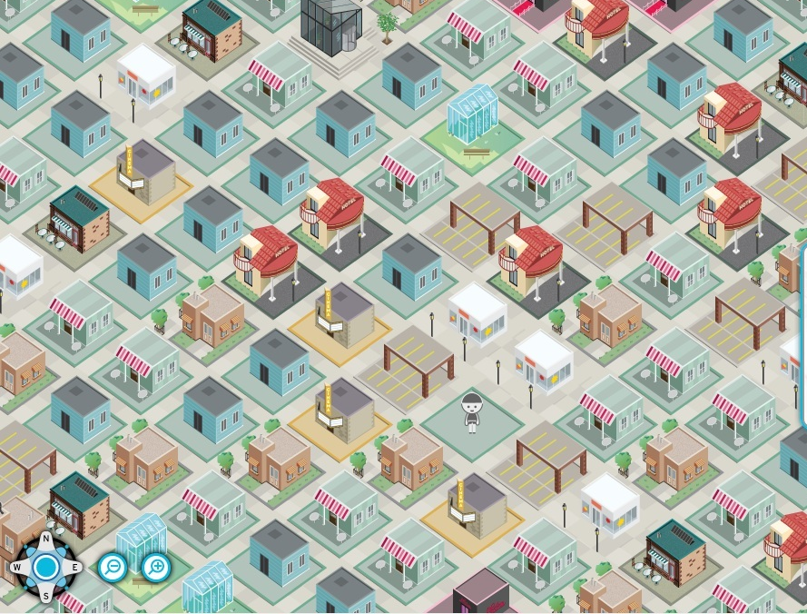
Clustering Districts
By using Kmeans clustering algorithm we cluster the district of Barcelona and their top 100 most venues.

Slide 6
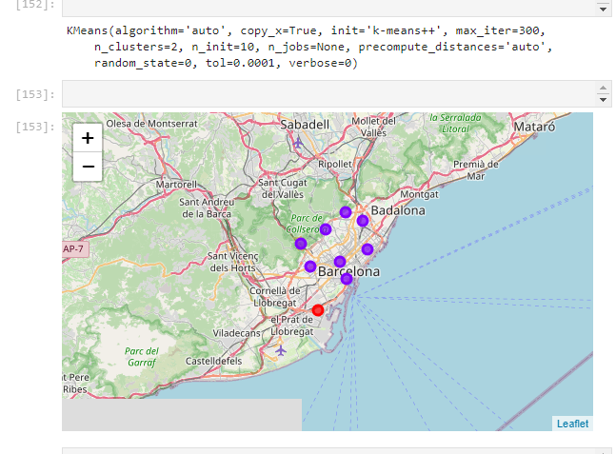
Conclusion
The best performance based on the silhouette_score we can create 2 cluster disctrict. The purple districts has more potantial for a new steak house Nusret. We recommend to open a new brach one of these district.

Slide 7
